Slide 1
Chapter 5
Short-Term and Working Memory
Notes:
Hi Everyone! This video starts our discussion on memory. As you’ll see, memory is highly complex and is made up of many different types. For this video, I’ll be discussing short-term and working memory. Later videos will discuss long-term memory

Slide 2
What Is Memory?
Memory: processes involved in retaining, retrieving, and using information about stimuli, images, events, ideas, and skills after the original information is no longer present
Active any time some past experience has an impact on how you think or behave now or in the future

Slide 3
Modal Model of Memory (1 of 3)
Atkinson and Shiffrin (1968)
Memory types:
  Sensory memory—initial stage that holds all incoming information for seconds or fractions of a second
  Short-term memory—holds five to seven items for about 15 to 20 seconds.
  Long-term memory—can hold a large amount of information for years or even decades

Slide 4
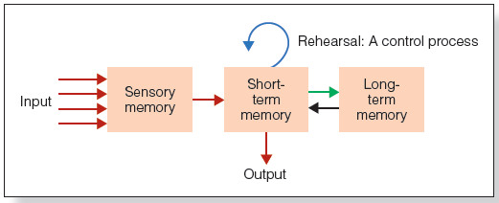
Modal Model of Memory (2 of 3)

Slide 5
Modal Model of Memory (3 of 3)
Control processes: active processes that can be controlled by the person
  Rehearsal
  Strategies used to make a stimulus more memorable
  Strategies of attention that help you focus on specific stimuli

Slide 6
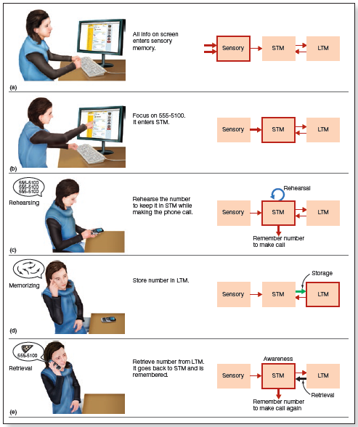
Notes:
Figure 5.3 What happens in different parts of Rachel’s memory as she is (a, b) looking up the phone number, (c) calling the pizza shop, and (d) memorizing the number. A few days later, (e) she retrieves the number from long-term memory to order pizza again. The parts of the modal model that are outlined in red indicate which processes are activated for each action that Rachel takes.

Slide 7
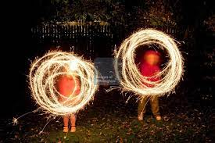
Modal Model of Memory: Sensory Memory (1 of 5)
Sensory memory: retention, for brief periods of time, of the effects of sensory stimulation.
  Information decays very quickly
Persistence of vision: retention of the perception of light
  Trail of light from a moving sparkler
  Frames in film

Slide 8
Modal Model of Memory: Sensory Memory (2 of 5)
Measuring the capacity and duration of sensory memory (Sperling, 1960)
  Array of letters flashed quickly on a screen
  Participants asked to report as many as possible
Whole report method: participants asked to report as many as could be seen
  Average of 4.5 out of 12 letters (37.5%)

Slide 9
Modal Model of Memory: Sensory Memory (3 of 5)
Partial report method: participants heard tone that told them which row of letters to report
  Average of 3.3 out of 4 letters (82%)
  Participants could report any of the rows
Delayed partial report method: presentation of tone delayed for a fraction of a second after the letters were extinguished
  Performance decreases rapidly

Slide 10
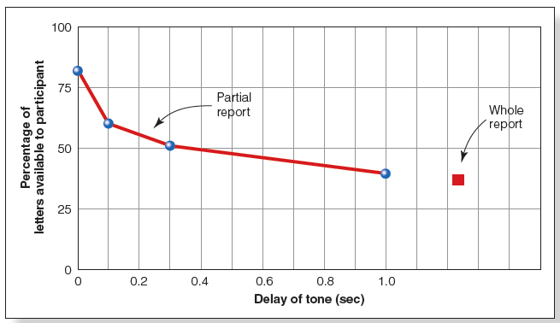
Modal Model of Memory: Sensory Memory (4 of 5)
Notes:
Figure 5.6 Results of Sperling’s (1960) partial report experiments. The decrease in performance is due to the rapid decay of iconic memory (sensory memory in the modal model).

Slide 11
Modal Model of Memory: Sensory Memory (5 of 5)
Iconic memory: brief sensory memory of the things that we see
  Responsible for persistence of vision
Echoic memory: brief sensory memory of the things that we hear
  Responsible for persistence of sound

Slide 12
Modal Model of Memory: Short-Term Memory (1 of 5)
Stores small amounts of information for a brief duration
Includes both new information received from the sensory stores and information recalled from long-term memory

Slide 13
Modal Model of Memory: Short-Term Memory (2 of 5)
Measuring duration of short-term memory
  Read three letters, then a three-digit number
  Begin counting backwards by threes
  After a set time, recall three letters
After 3 seconds of counting, participants performed at 80%
After 18 seconds of counting, participants performed at 10%
Reduction in performance explained by decay, the vanishing of a memory trace due to the passage of time and exposure to competing stimuli

Slide 14
Modal Model of Memory: Short-Term Memory (3 of 5)
Capacity of short-term memory
  Digit span: how many digits a person can remember
    Typical result: five to eight items
    But what is an item?
Chunking: small units can be combined into larger meaningful units
  Chunk is a collection of elements strongly associated with one another but weakly associated with elements in other chunks
6 6 2 8 9 5 3 0 0 5
662 895 3005

Slide 15
Modal Model of Memory: Short-Term Memory (4 of 5)
Ericsson et al. (1980)
  Trained a college student with average memory ability to use chunking
    Student had initial digit span of 7
  After 230 one-hour training sessions, student could remember up to 79 digits
    Chunking them into meaningful units
Alvarez & Cavanagh (2004)
  Used colored squares as well as complex objects
  Used the change detection procedure

Slide 16
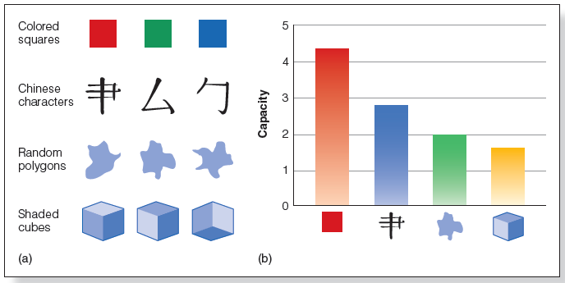
Modal Model of Memory: Short-Term Memory (5 of 5)
Notes:
Figure 5.9 (a) Some of the stimuli used in Alvarez and Cavanagh’s (2004) change detection experiment. The stimuli range from low information (colored squares) to high information (cubes). In the actual experiments, there were six different objects in each set. (b) Results showing the average number of objects that could be remembered for each type of stimulus.

Slide 17
Working Memory (1 of 4)
Similar concept to short-term memory
Baddeley and Hitch (1974)
Working memory:
  Limited-capacity system for temporary storage and manipulation of information for complex tasks such as comprehension, learning, and reasoning
Working memory differs from short-term memory (STM)
  STM holds information for a brief period of time
  WM is concerned with the storage, processing and manipulation of information, and is active during complex cognition

Slide 18
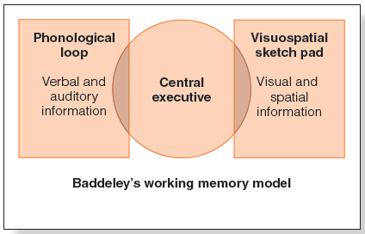
Working Memory (2 of 4)
Notes:
Figure 5.10 Diagram of the three main components of Baddeley and Hitch’s (1974; Baddeley, 2000) model of working memory: the phonological loop, the visuospatial sketch pad, and the central executive.

Slide 19
Working Memory (3 of 4)
Working memory is set up to process different types of information simultaneously
Has trouble when similar types of information are presented at the same time

Slide 20
Phonological Loop (1 of 2)
Phonological similarity effect
  Letters or words that sound similar are confused
Word length effect
  Memory for lists of words is better for short words than for long words
  Takes longer to rehearse long words and to produce them during recall

Slide 21
Phonological Loop (2 of 2)
Articulatory suppression
  Speaking prevents one from rehearsing items to be remembered
    Reduces memory span
    Eliminates word length effect
    Reduces phonological similarity effect for reading words

Slide 22
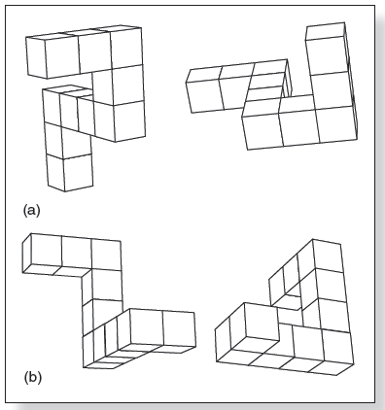
Visuospatial Sketch Pad
Creation of visual images in the mind in the absence of a physical visual stimulus
  Shepard and Metzler (1971)
  Mental rotation task
  Tasks that called for greater rotations took longer
Notes:
(Source: Based on R. N. Shepard & J. Metzler, Mental rotation of three-dimensional objects, Science, 171, Figures 1a & b, 701–703, 1971.)

Slide 23
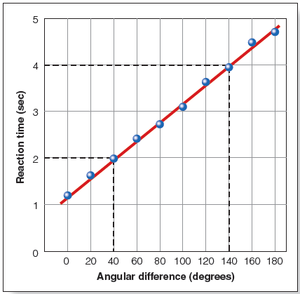
Working Memory (4 of 4)
Notes:
Figure 5.14 Results of Shepard and Metzler’s (1971) mental rotation experiment.

Slide 24
The Central Executive
Acts as the attention controller
  Focus, divide, switch attention
Controls suppression of irrelevant information
Perseveration: repeatedly performing the same action or thought even if it is not achieving the desired goal

Slide 25
The Episodic Buffer (1 of 2)
Backup store that communicates with long-term and working memory components
Hold information longer and has greater capacity than phonological loop or visuospatial sketch pad

Slide 26
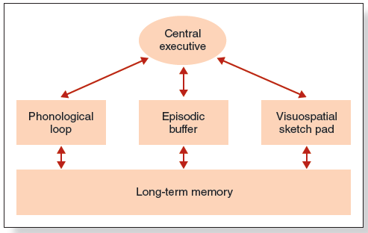
The Episodic Buffer (2 of 2)
Notes:
Figure 5.18 Baddeley’s revised working memory model, which contains the original three components plus the episodic buffer.

Slide 27
Working Memory and the Brain (1 of 3)
Prefrontal cortex responsible for processing incoming visual and auditory information
  Monkeys without a prefrontal cortex have difficulty holding information in working memory
Funahashi and Colleagues (1989)
  Single cell recordings from monkey’s prefrontal cortex during a delayed-response task

Slide 28
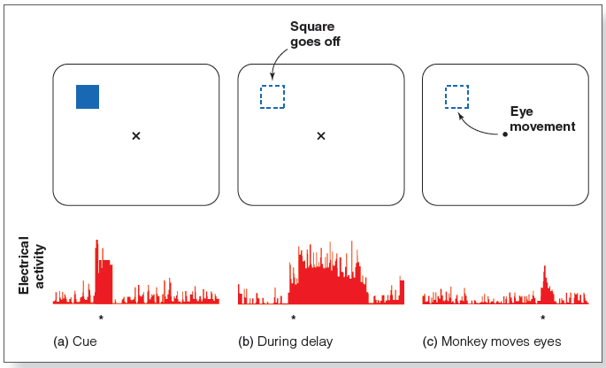
Working Memory and the Brain (2 of 3)
Notes:
Figure 5.22 Results of an experiment showing the response of neurons in the monkey’s prefrontal cortex during an attentional task. Neural responding is indicated by an asterisk (*). (a) A cue square is flashed at a particular position, causing the neuron to respond. (b) The square goes off, but the neuron continues to respond during the delay. (c) The fixation X goes off, and the monkey demonstrates its memory for the location of the square by moving its eyes to where the square was.

Slide 29
Working Memory and the Brain (3 of 3)
Neurons responded when stimulus was flashed in a particular location and during delay
Information remains available via these neurons for as long as they continue firing

Slide 30
Working Memory and Neural Dynamics (1 of 2)
Stokes (2015)
  Information is stored in short-term changes in neural networks
Activity-silent working memory:
  Activity state: information to be remembered causes neurons to fire
  Synaptic state: neuron firing stops, but connections between neurons are strengthened

Slide 31
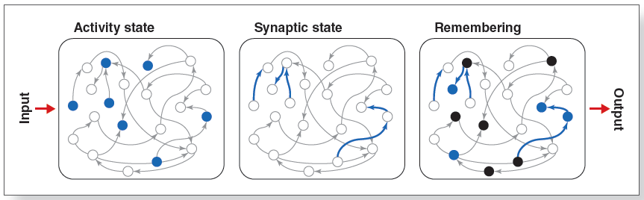
Working Memory and Neural Dynamics (2 of 2)
Notes:
Figure 5.23 Diagram showing Stokes’s (2015) proposal that information can be stored in working memory by changes in the connectivity of a neural network. (a) Activity state, showing that some neurons in the network (blue circles) are activated by the incoming stimulus. (b) Synaptic state, showing connections that have been strengthened between neurons in the network (blue lines). (c) Activity associated with the memory

Slide 32
Working Memory and Individual Capacity (1 of 2)
Vogel et al.(2005) determined participants’ WM
  High-capacity WM group
  Low-capacity WM group
Shown either simple or complex stimuli
Measured ERP responses
  High-capacity participants were more efficient at ignoring the distractors

Slide 33
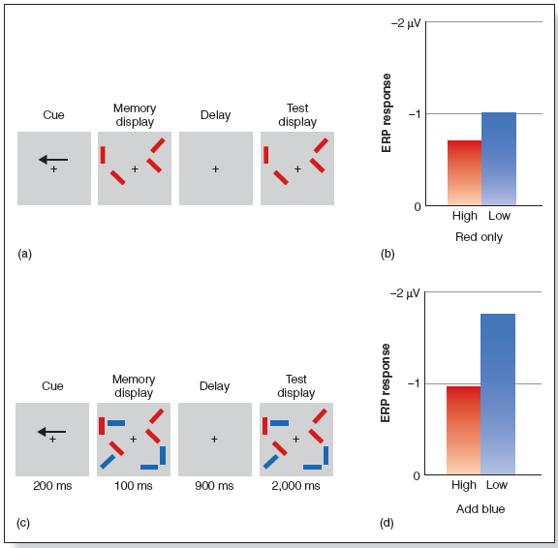
Working Memory and Individual Capacity (2 of 2)
Notes:
Figure 5.25 (a) Sequence for the Vogel et al. (2005) task. The arrow in this example tells the participant to pay attention to the left side of the memory and test displays. The task is to indicate whether the red rectangles on the attended side are the same or different in the two displays. (b) ERP response for low- and highcapacity participants for the task in part (a). (c) Display with blue bars added. These bars are added to distract the participants, who are supposed to be focusing on the red rectangles. (d) ERP response for the task in part (c).

